Slide 1
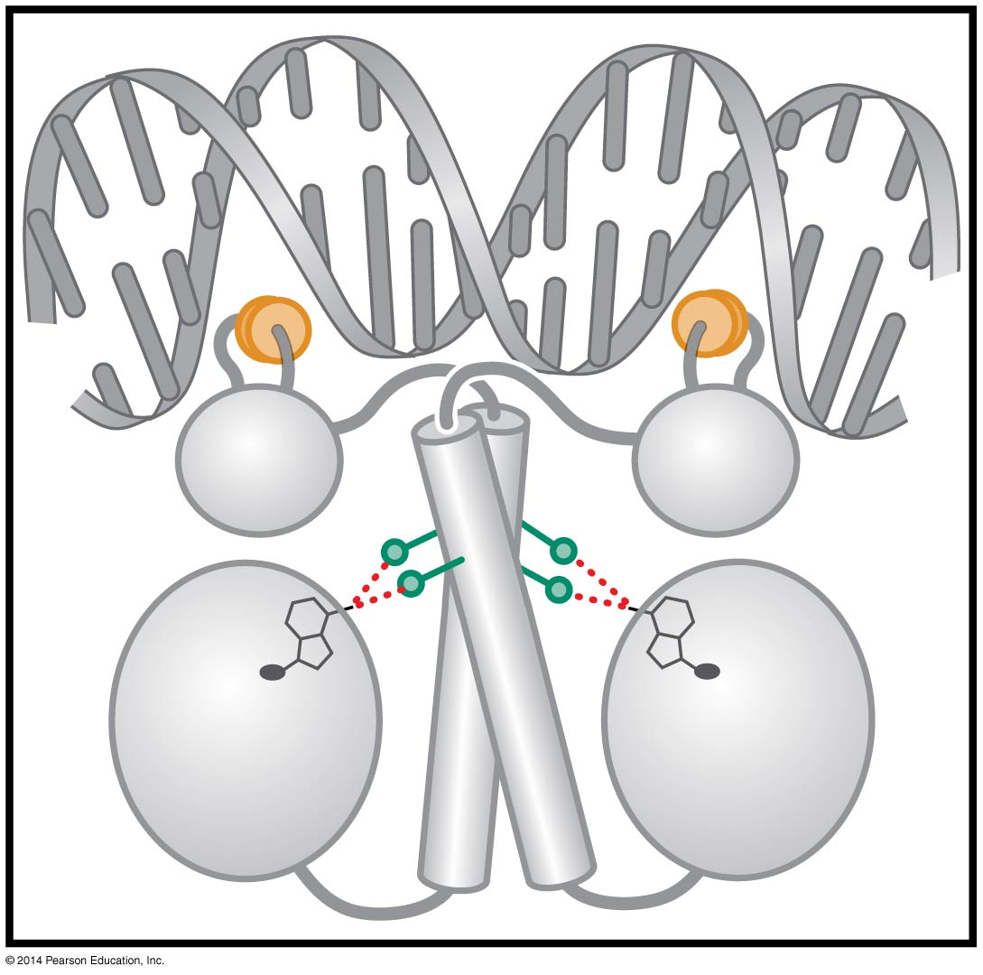
transcriptional regulation in Prokaryotes
BT 454
Chapter 18

Slide 2
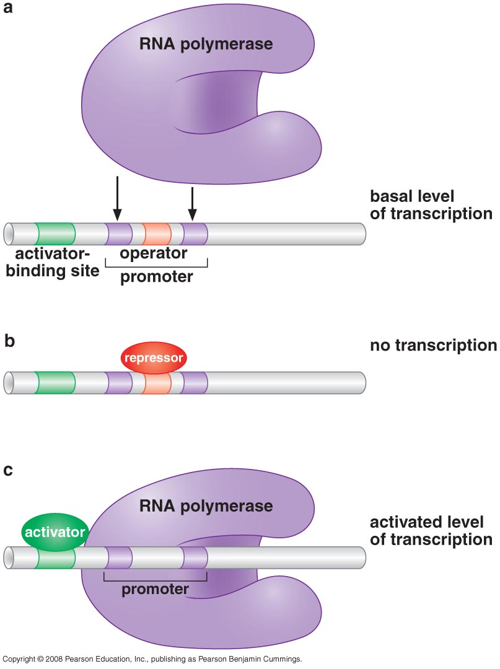
Principles of transcriptional regulation
Gene expression is controlled by regulatory proteins
  activators
  repressors
Most activators & repressors act at the level of transcription initiation

Slide 3
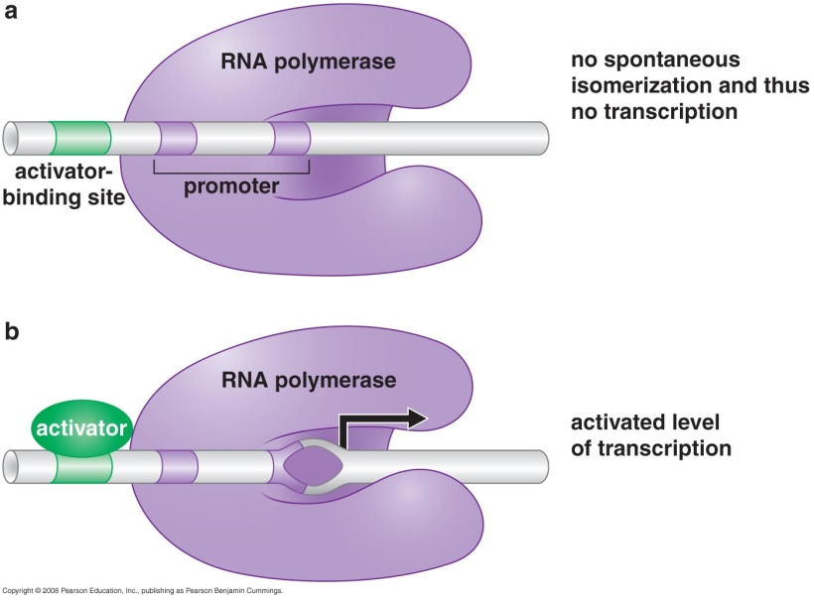
Principles of transcriptional regulation
Many promoters are regulated by activators that help RNA polymerase bind DNA and by repressors that block that binding
Activators can act by inducing
change in the conformation of
RNA polymerase (Allostery)

Slide 4
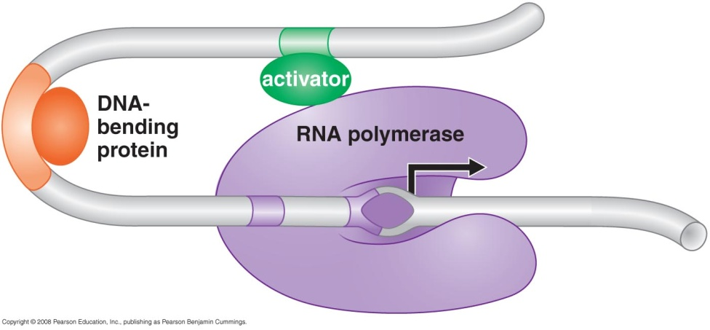
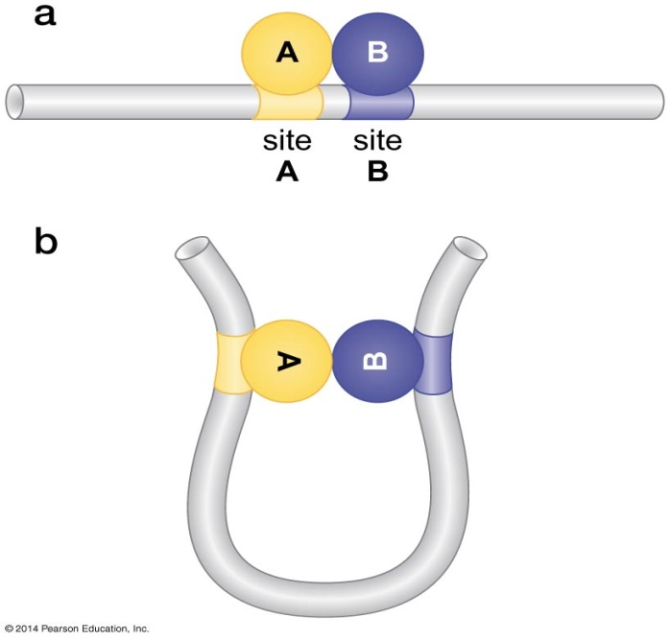
Principles of transcriptional regulation
Action at a distance and DNA looping
  Binding is facilitated by architectural proteins
Regulation could occur at elongation or termination level

Slide 5
Regulation of Transcription Initiation: Examples From Bacteria
EXAMPLE ONE: Lac Operon
EXAMPLE TWO: Alternative sigma factors
EXAMPLE THREE: transcriptional activators NtrC and MerR
EXAMPLE FOUR: AraBAD Operon ; is activated if arabinose is present and glucose is absent

Slide 6
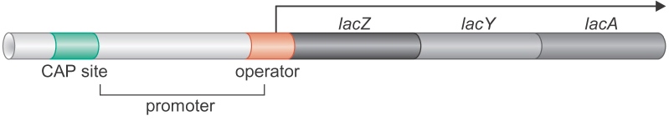
EXAMPLE ONE:
Lac Operon
Lac regulatory system
  a regulatory gene
  3 structural genes
  2 control elements

Slide 7
Lac regulatory system
Regulatory gene
Structural Genes
Cis-acting elements
lacI
lacZ
^{lacY}
lacA
DNA
P_{lacI}
P_{lac}
O_{lac}
m-RNA
Protein
β -Galactosidase
Transacetylase
Permease

Slide 8
lacZ
β-galactosidase → cleaves lactose into glucose + galactose
permease → cell membrane protein transport Lactose into the cell
lacY
lacA
thiogalactoside transacetylase → to get rid of the toxic thiogalactosides

Slide 9
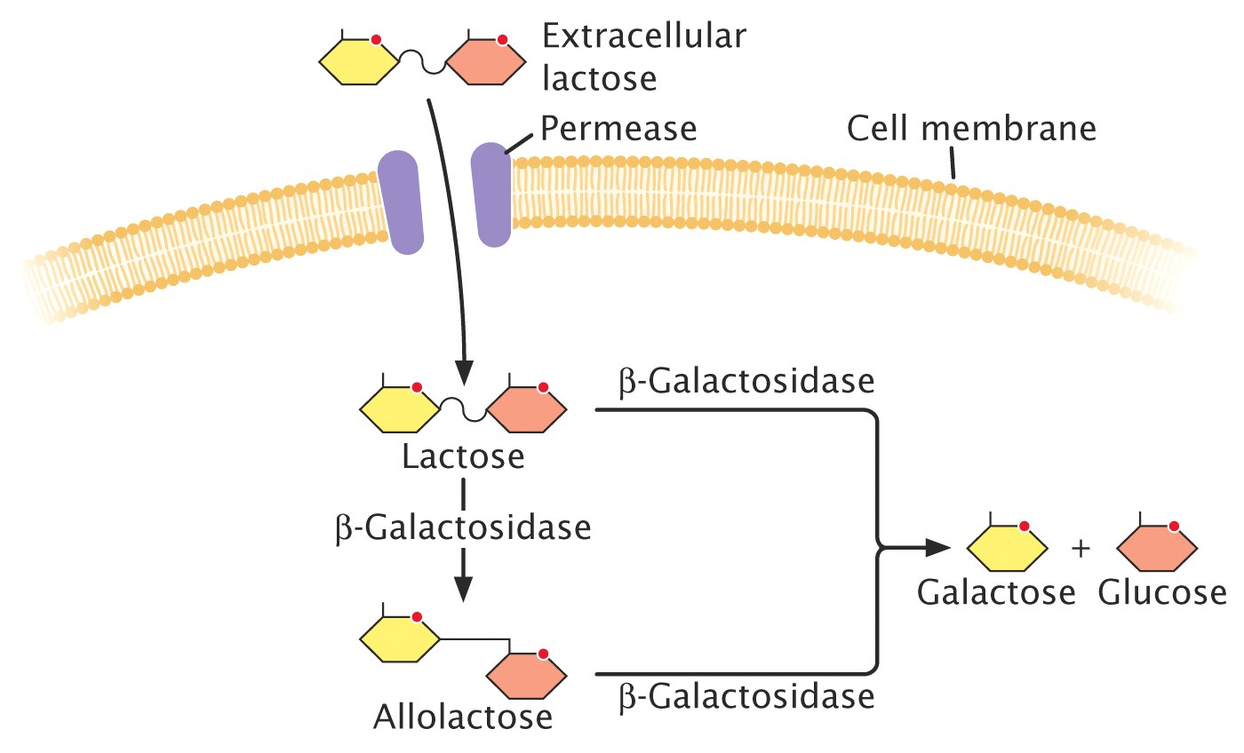

Slide 10
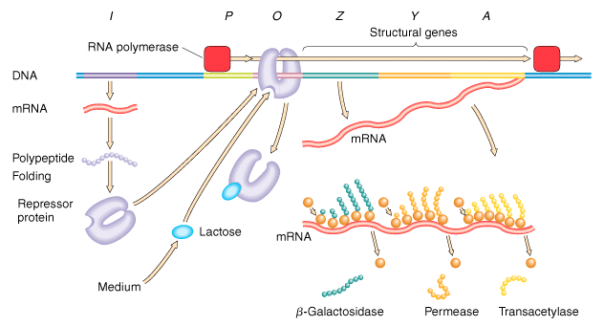

Slide 11
An Activator and a Repressor Together Control the lac Genes
The activator is called CAP( Catabolite Activator Protein )
CAP binds DNA (activate the lac genes) only in the absence of glucose
The lac repressor can bind DNA and repress transcription only in the absence of lactose
Both CAP and lac repressor are DNA-binding proteins and each binds to a specific site in DNA at or near the lac promoter.

Slide 12
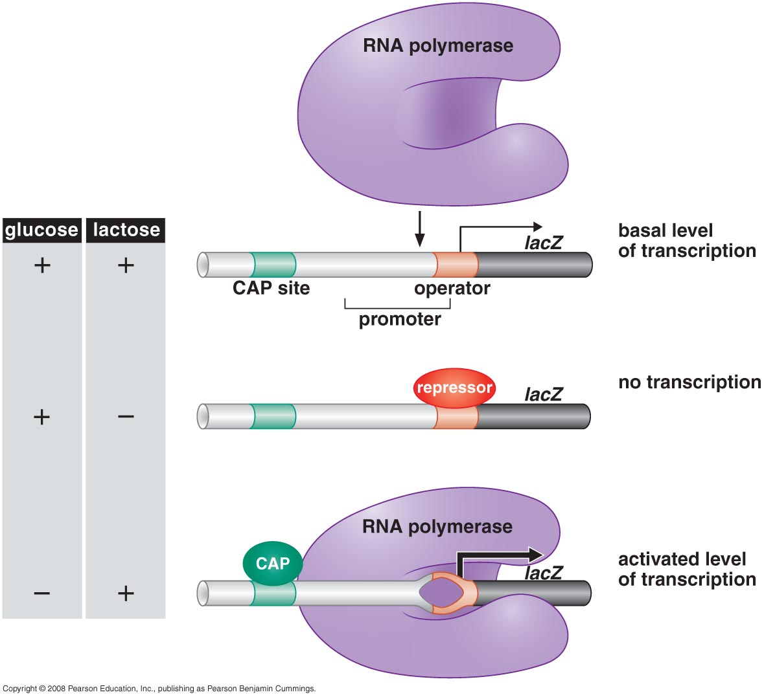

Slide 13
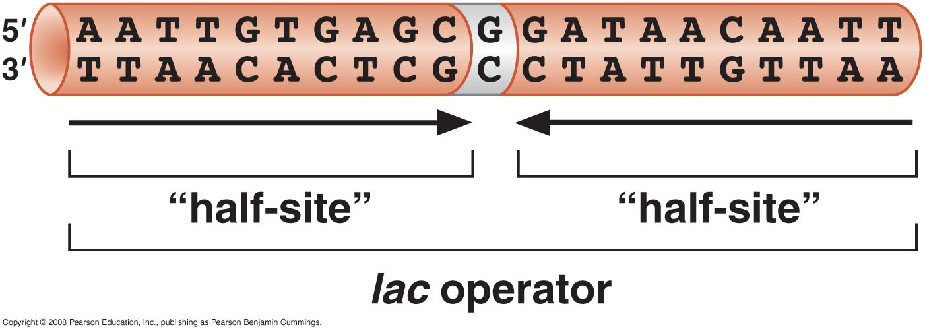
Lac operator
21 bp twofold symmetric and is recognized by two subunits of lac repressor, one binding to each half-site

Slide 14
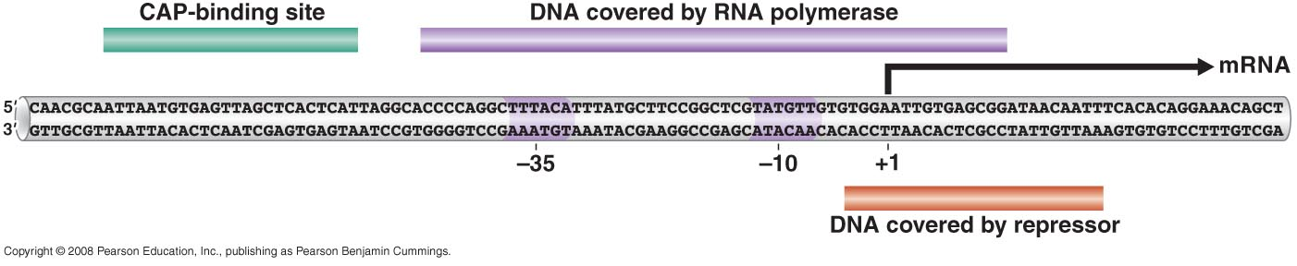
Lac operator
lac operator overlaps promoter, and so repressor bound to the operator physically prevents RNA polymerase from binding to the promoter.

Slide 15
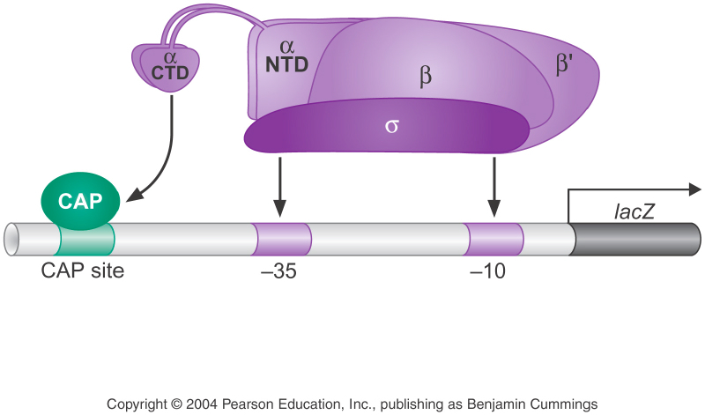
CAP
CAP binds as a dimer to a site similar in length to the lac operator, but different in sequence and location.
CAP has separate activating and DNA-binding surfaces.
At the promoter, where there is no UP-element, a CTD binds to CAP and adjacent DNA instead.

Slide 16
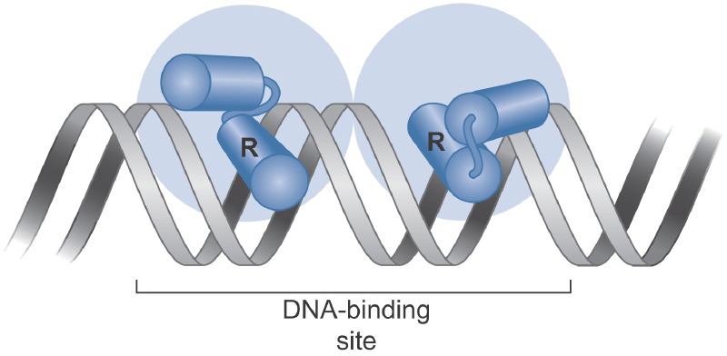
CAP and lac repressor bind DNA using a common structural motif
The protein binds as a homodimer to a site that is an inverted repeat or near repeat.
Both CAP and lac repressor bind DNA using a helix-turn-helix motif.
Recognition helix can fits into the
major groove of the DNA
The second helix makes contact
with DNA backbone →
  ensuring proper presentation of the recognition helix
  adds binding energy

Slide 17
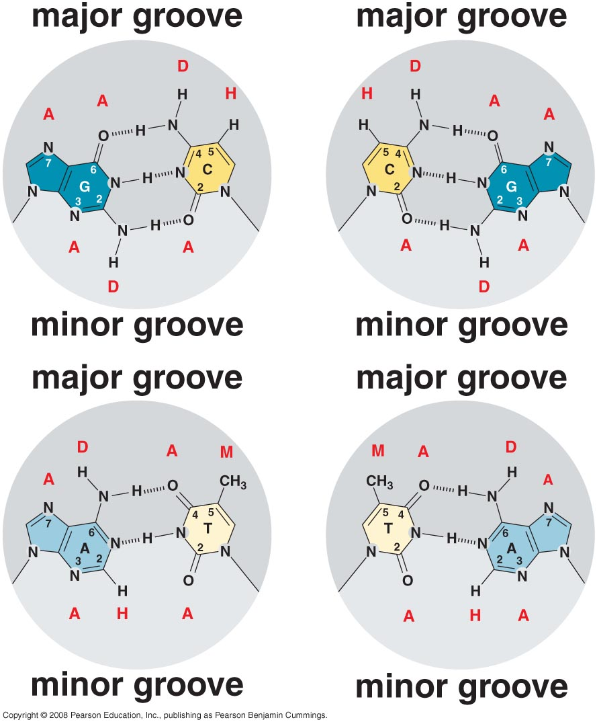

Slide 18
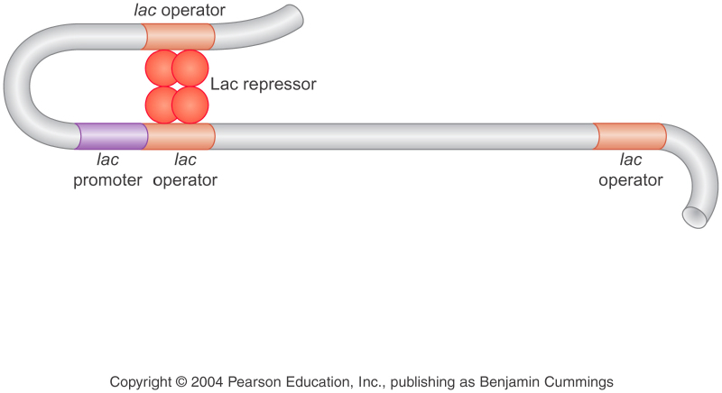
Differences & Exceptions
Lac repressor binds as a tetramer, with each operator is contacted by a repressor dimer.

Slide 19
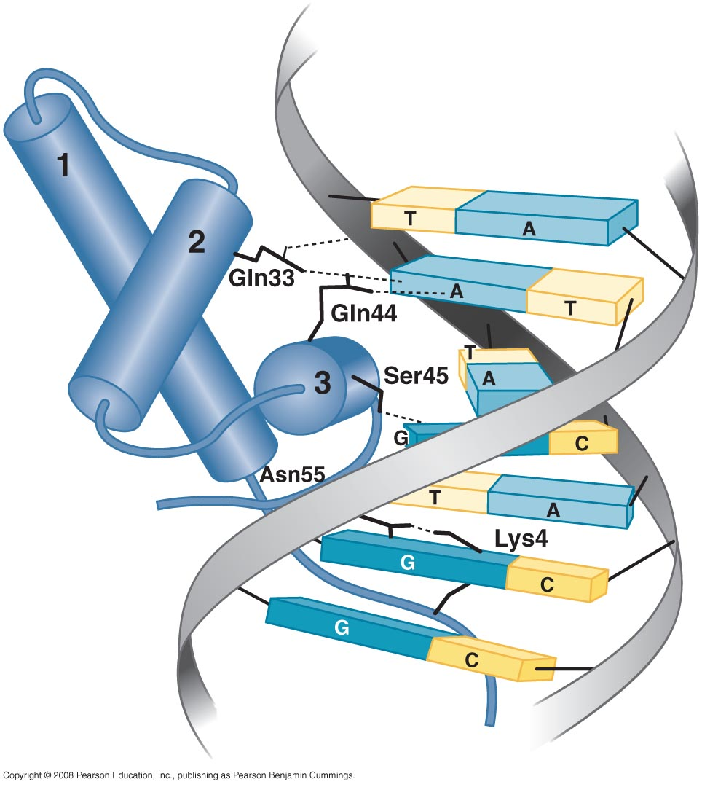
Differences & Exceptions
In some cases, other regions of the protein, outside the helix-turn-helix domain, also interact with the DNA.
In some cases, however, various distortions are seen in the protein-DNA complex.

Slide 20
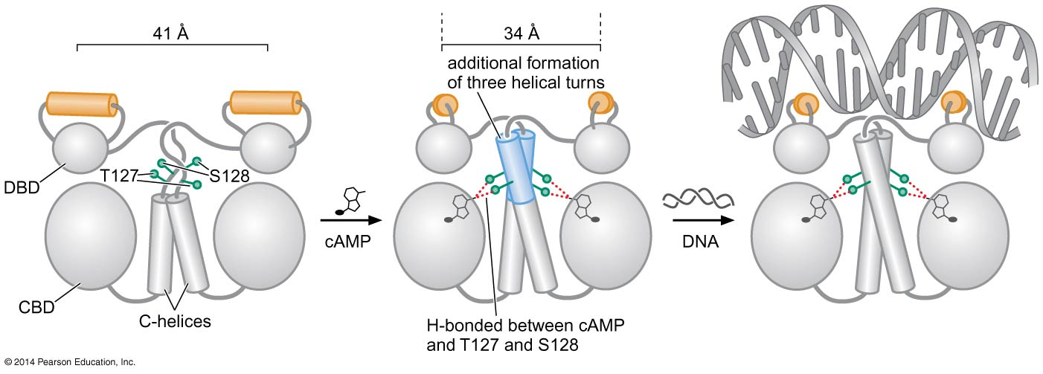
The activity of Lac repressor and CAP are controlled allosterically by their signals
Binding of the corresponding signals alter the structure of these two regulatory proteins.

Slide 21
Response to lactose
Absence of lactose
Lack of inducer: the lac repressor block all but a very low level of trans-cription of lacZYA .
i
^{p}
o
z
^{y}
a
Active
Very low level of lac mRNA
Lactose is present, the low basal level of permease allows its uptake, andβ-galactosidase catalyzes the conversion of some lactose to allolactose.
Allolactose acts as an inducer, binding to the lac repressor and inactivate it.
Presence of lactose
i
^{p}
o
z
^{y}
a
Inactive
Permease
β-Galactosidase
Transacetylase

Slide 22
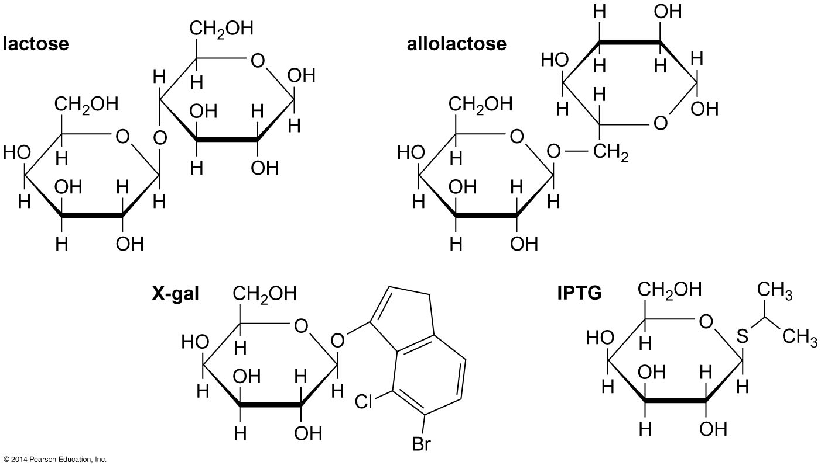
Allolactose acts as an inducer, binding to the lac repressor and inactivate it.

Slide 23
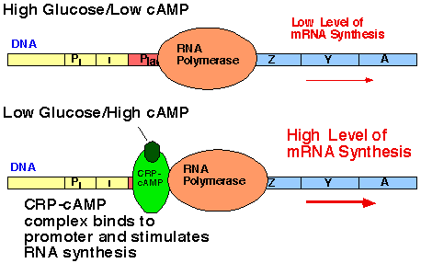
Response to glucose

Slide 24
Signal Integration
Expression of Lac genes is controlled by two signals (glucose & lactose levels), each of which is communicated to the genes via a single regulator—the lac repressor and CAP, respectively

Slide 25
Combinatorial Control
combinatorial control refers to the way that groups of regulatory proteins work together to determine the expression of a single gene.
A regulator (CAP) works together with different repressor at different genes

Slide 26
EXAMPLE TWO
Alternative sigma factors
σsubunit of RNA polymerase that recognizes the promoter sequences
Alternative σ factor direct RNA polymerase to alternative site of promoters
Many bacteria produce alternative sets of σ factors to meet the regulation requirements of transcription under normal and extreme growth condition

Slide 27
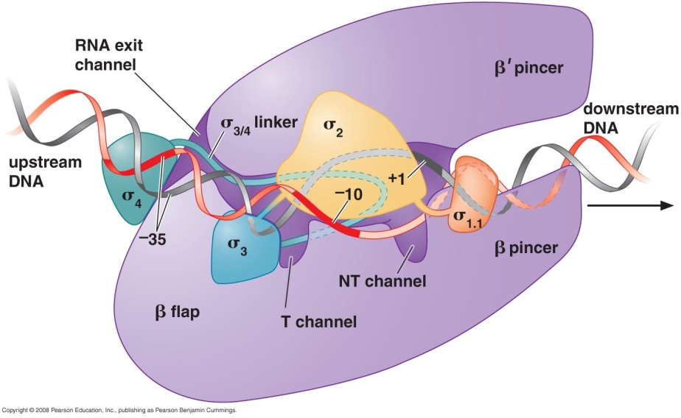
Structure of Bacterial RNA polymerase
Core polymerase enzyme → catalyze polymerization
σ transcription factor → binds to promoter
Together form the holoenzyme
What would happen if
there is no σ?

Slide 28
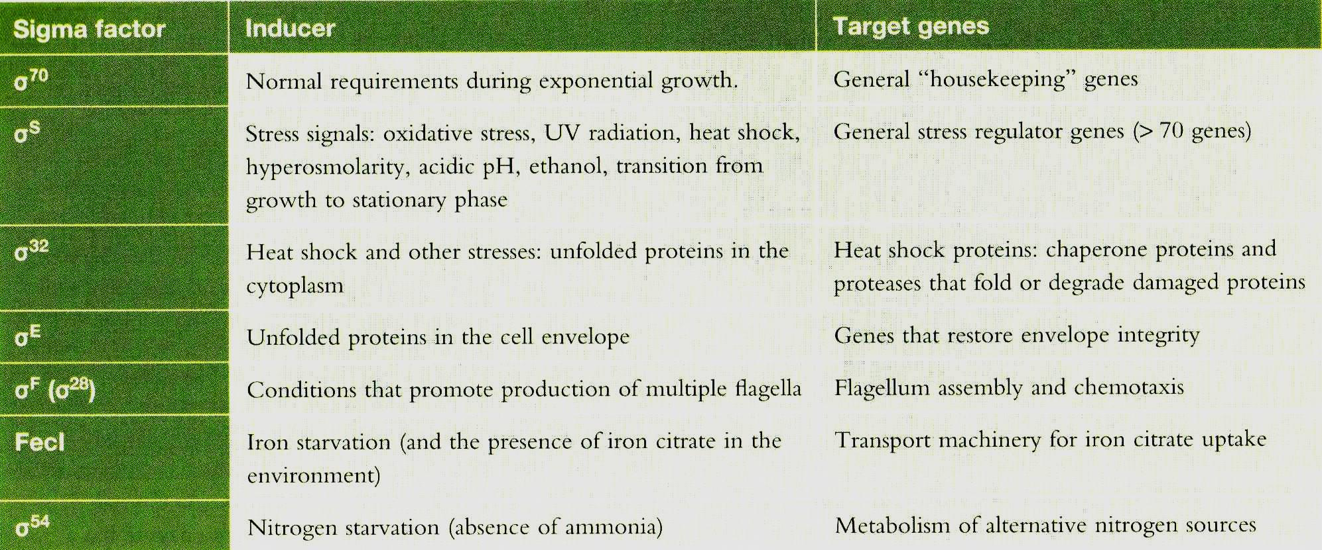
Alternative E.coli sigma factors

Slide 29
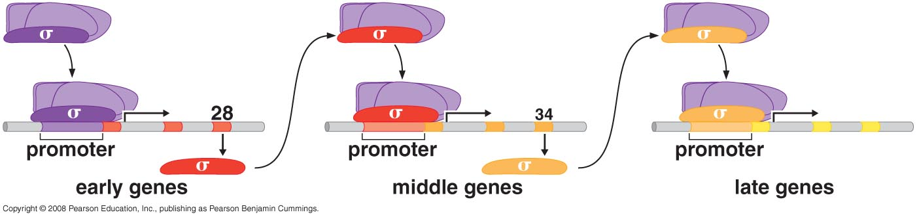
EXAMPLE TWO
Alternative sigma factors
B. subtilis SPO1 phage expresses a cascade of σ factors which allow a defined sequence of expression of different phage genes (Recruitment)

Slide 30
Normal bacterial holoenzyme
Express early genes
Encode σ²⁸
Express middle genes (gene 34 and 33 )
Encode σ factor for transcription of late genes

Slide 31
EXAMPLE THREE
NtrC and MerR
NtrC and Mert: Transcriptional Activators that Work by Allostery Rather than by Recruitment
NtrC controls expression of genes involved in nitrogen metabolism, such as the glnA gene (E.coli glutamine synthetase operon).

Slide 32
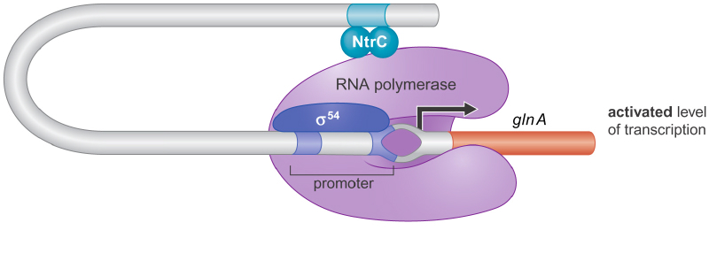
NtrC Has ATPase Activity and Works from DNA Sites Far from the Gene
NtrC has separate activating and DNA-binding domains, and binds DNA only when the nitrogen levels are low.

Slide 33
The major process:
Low nitrogen levels
Trigger polymerase to initiate transcription
NtrB phosphorylates NtrC
NtrC’s DNA-binding domain revealed
ATP hydrolysis and conformation change in polymerase
NtrC binds four sites located ~ 150 base pairs upstream of the promoter
NtrC interacts with σ54

Slide 34
MerR activates transcription by twisting promoter DNA
MerR controls a gene called merT, which encodes an enzyme that makes cells resistant to the toxic effects of mercury
In the presence of mercury, MerR binds to a sequence between –10 and –35 regions of the merT promoter and activates merT expression.

Slide 35
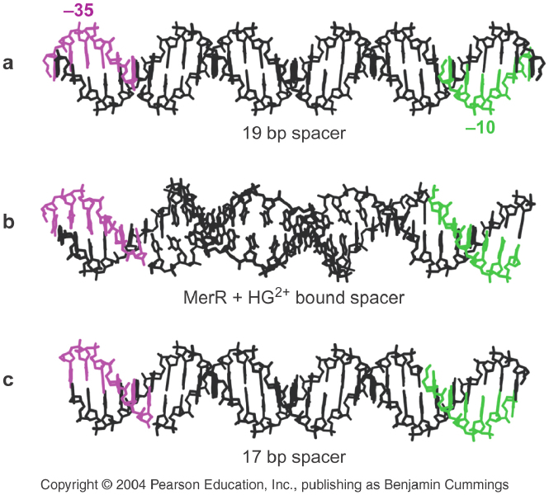
Distance between the -10 and -35 elements is 19 bp instead of 15-17bp
-35 & -10 elements are aligned differently

Slide 36
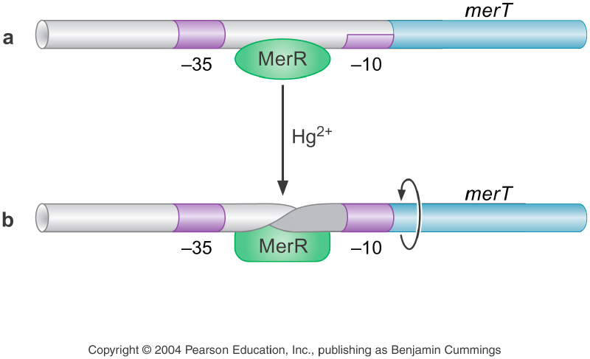
NO Hg2+ → MerR locks the promoter in the unpropitious conformation
Hg2+ is present → MerR binds Hg2+ → change in conformation → twists the promoter to restore its structure

Slide 37
Repressors work in different ways
Binding to a site overlapping the promoter →blocks RNA polymerase binding. (lac repressor)
The protein holds the promoter in a conformation incompatible with transcription initiation. (the MerR case)
Blocking the transition from the closed to open complex. (E.coli Gal repressor)
Preventing RNA polymerase from escape by binding close to strong promoter and binding with RNA polymerase

Slide 38
EXAMPLE FOUR
AraBAD Operon
araBAD operon from is activated if arabinose is present and glucose is absent
Directs expression of genes encoding enzymes required for arabinose metabolism
Two activators (AraC and CAP) and No repressor control of the araBAD operon by antiactivation

Slide 39
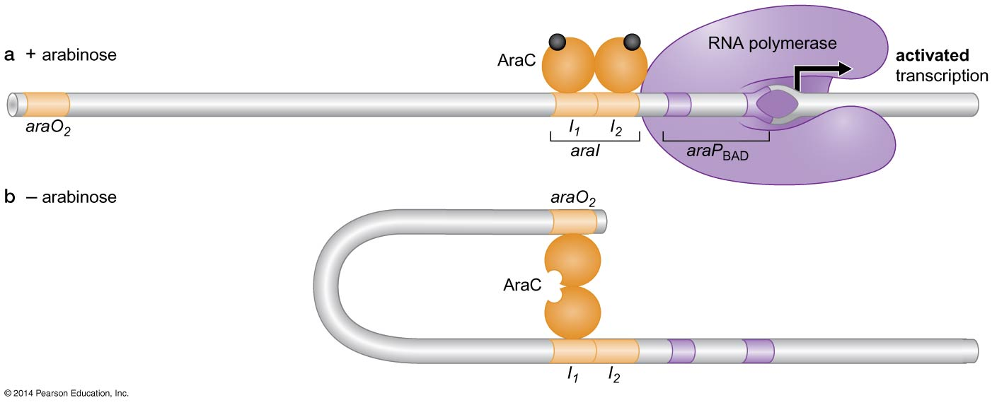
Control of the araBAD operon:
Arabinose + AraC = dimer binding to activating sequence araI₁ and araI₂
No arabinose = AraC dimer change conformation + araO2 suppress sequence

Slide 40
The magnitude of induction of the araBAD promoter by arabinose is very large , and for this reason the promoter is often used in expression vectors.
Expression vectors are DNA constructs in which efficient synthesis of any protein can be ensured by fusing a gene to a strong promoter .

Slide 41
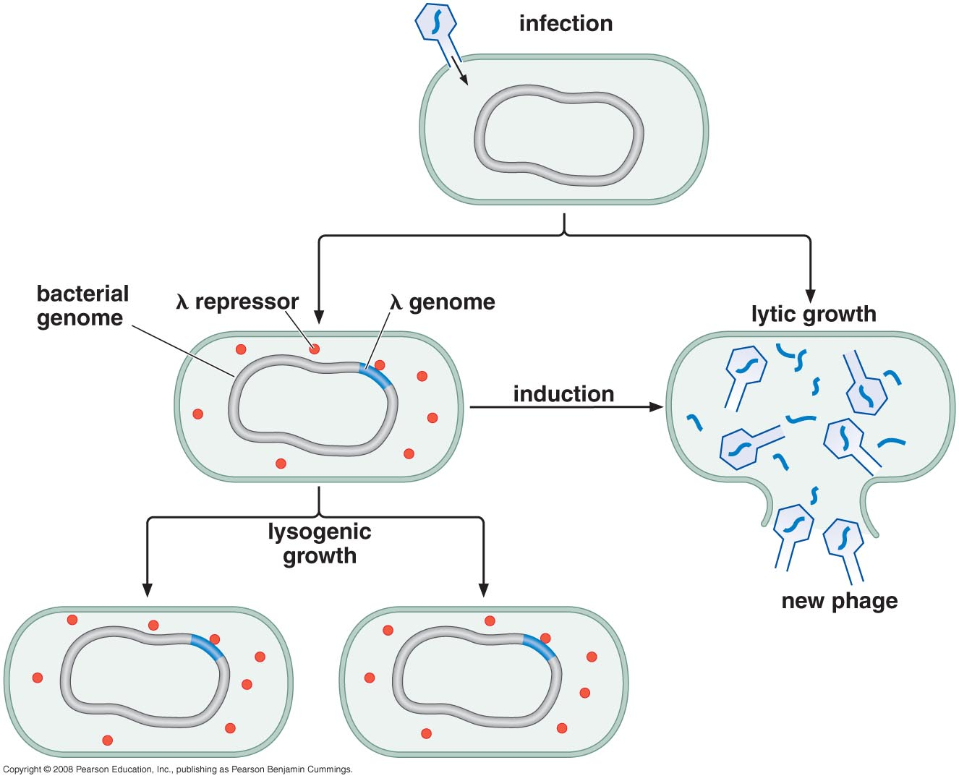
The case of bacteriophage λ: Layers of regulation
Which pathway is determined by which of the alternative programs of gene expression is adopted

Slide 42
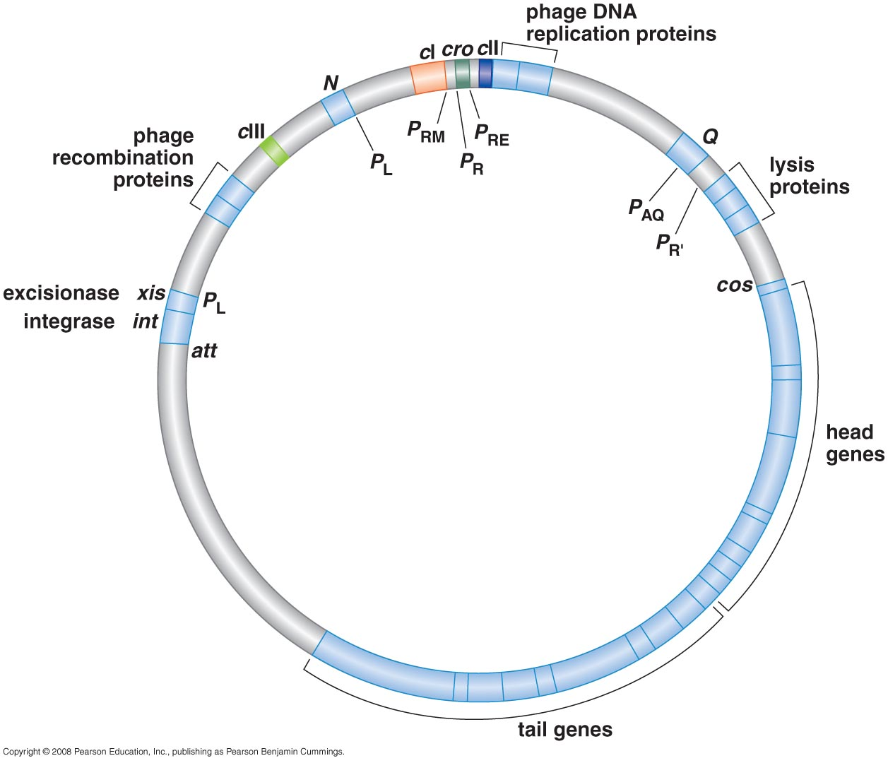
λ Phage genome
50 kb genome
~50 gene

Slide 43
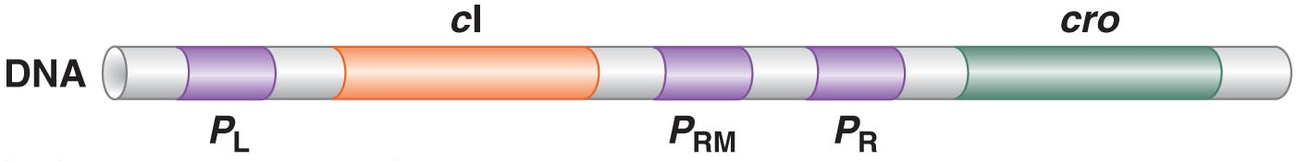
cI gene → λ repressor
Cro gene → control of repressor & other things
P_{L} → leftward promoter
P_{R} → rightward promoter
P_{RM} →repressor maintenance promoter

Slide 44
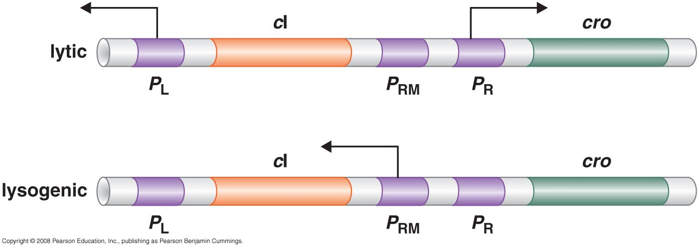

Two arrangements of gene expression

Slide 45
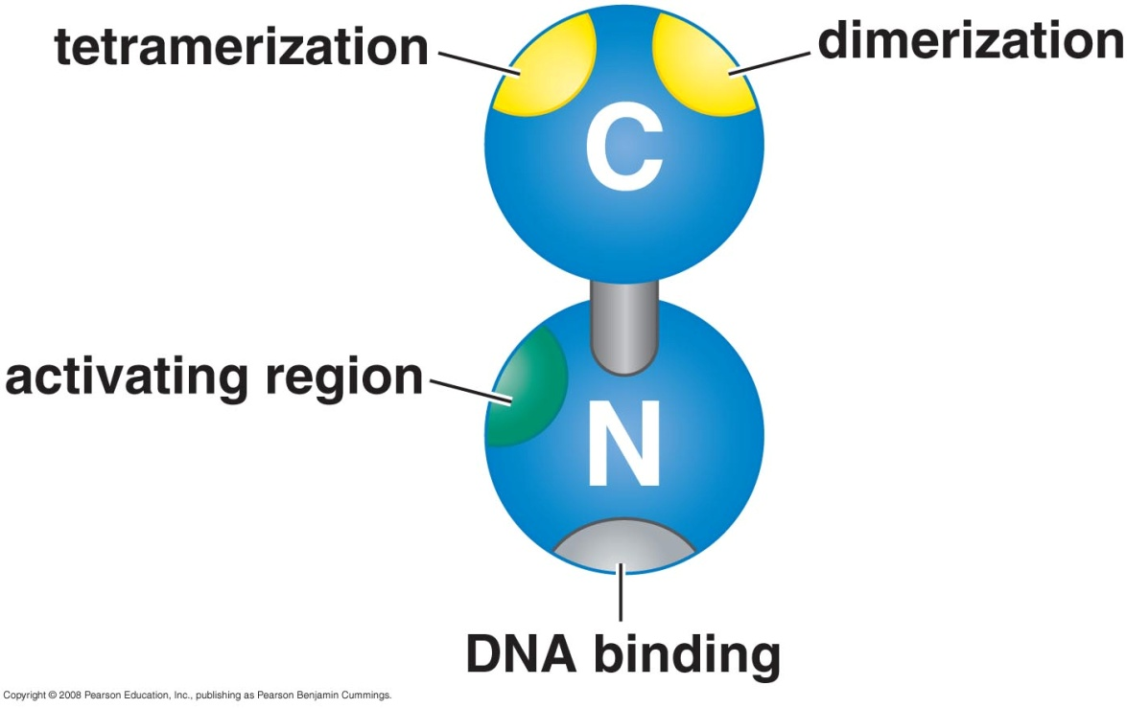

Regulatory proteins & their binding sites
1- λ repressor
Bind as a dimer
It can activate & repress
Repression by binding to sites overlap promoter
Activation by recruiting polymerase

Slide 46
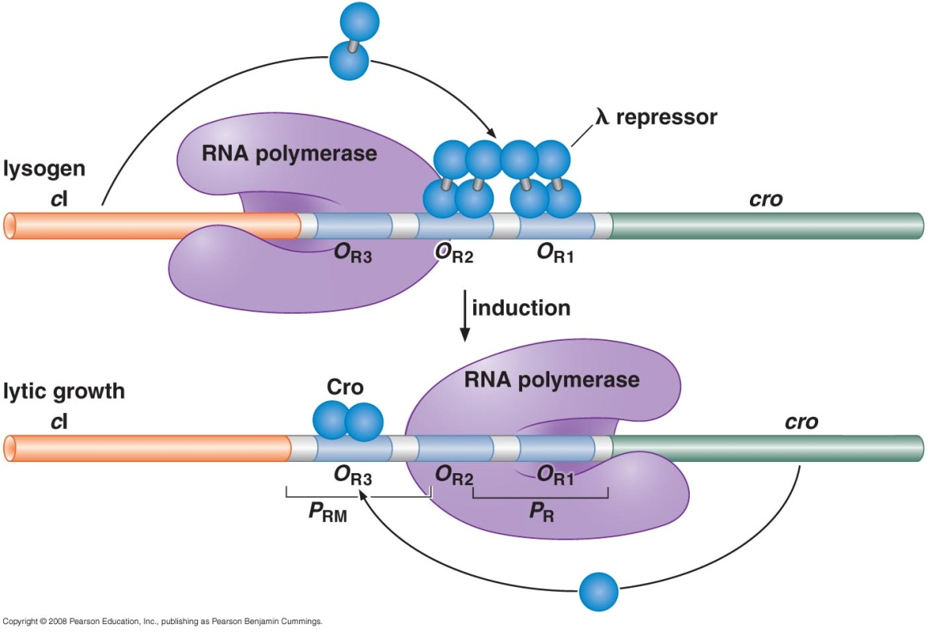
Regulatory proteins & their binding sites
2- Cro (Control of Repressor & Other things)
Repress transcription by overlapping polymerase binding site
Single domain protein
Binds as dimer using HTH motif

Slide 47
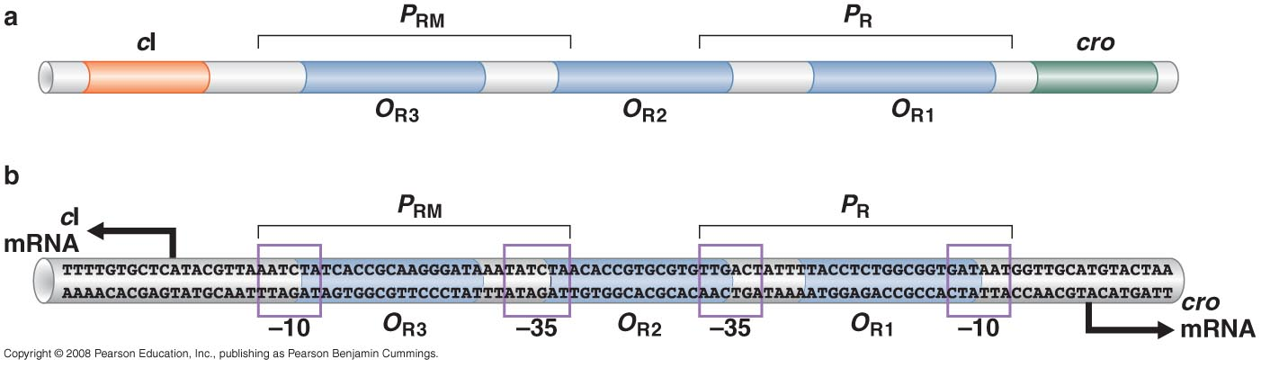
Operators recognised by λ repressor & Cro
6 operators: 3 on the Right and 3 on the Left
Consensus sequences
λ repressor has highest affinity (10 folds) to O_{R1}
Cro has highest affinity (10 folds) to O_{R3}

Slide 48
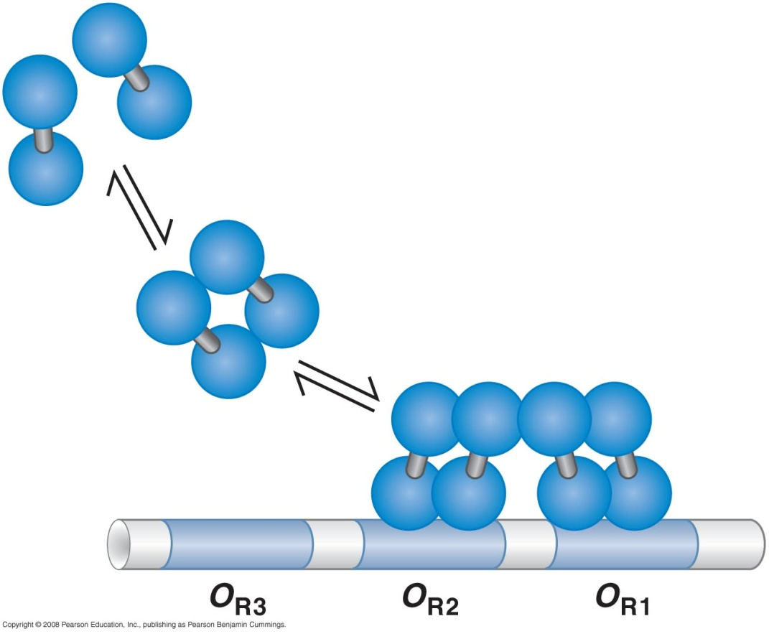
λ Repressor binds to operator sites cooperatively
λ Repressor is recruited to O_{R2} through cooperative binding with repressor in O_{R1} via tetramerization domain
λ Repressor in O_{R2}
Can’t recruit λ Repressor to O_{R3}
Dramatic change in expression
induced by small change in signal

Slide 49

Control of lytic & lysogenic growth
P_{RM} is a weak promoter while P_{R} and P_{L} are strong promoters
Lytic growth → cro repressor binds to O_{R3} which overlaps with P_{RM}
Lysogenic growth → λ repressor binds to O_{R1} & O_{R2} which overlaps with P_{R} & recruit RNA polymerase to P_{RM} via activating domain

Slide 50
Induction
Induction = switch from lysogenic to lytic growth
λ phage sense that cell is in SOS response condition: The is a global response to DNA damage in which the cell cycle is arrested and DNA repair and mutagenesis are induced. The system involves the expression of RecA protein (Rad51 in eukaryotes)
RecA do proteolysis to λ repressor → release λ repressor from O_{R1} & O_{R2}
Level of repressor is tightly regulated by positive & negative autoregulation to control induction process
Notes:
Positive autoregulation: doesn’t allow level of repressor to go too low by basal level of transcription
Negative autoregulation: when too much repressor is procued it occupies the OR3 (it requires 10 times conc. Needed to bind to OR1) and hence it will prevent RNA polymerase from binding to PRE (it act just as Cro)

Slide 51
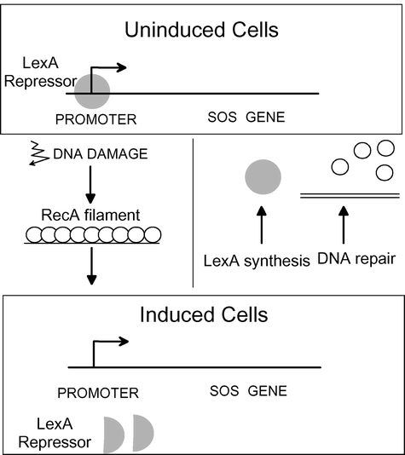
The SOS response
RecA produced whenever ssDNA exists
RecA:
  Proteolysis of LexA
  (the SOS genes are negatively regulated by LexA repressor protein dimers)
  ↓
  Transcription of SOS gene
  Activate UmuD → UmuD`

Slide 52
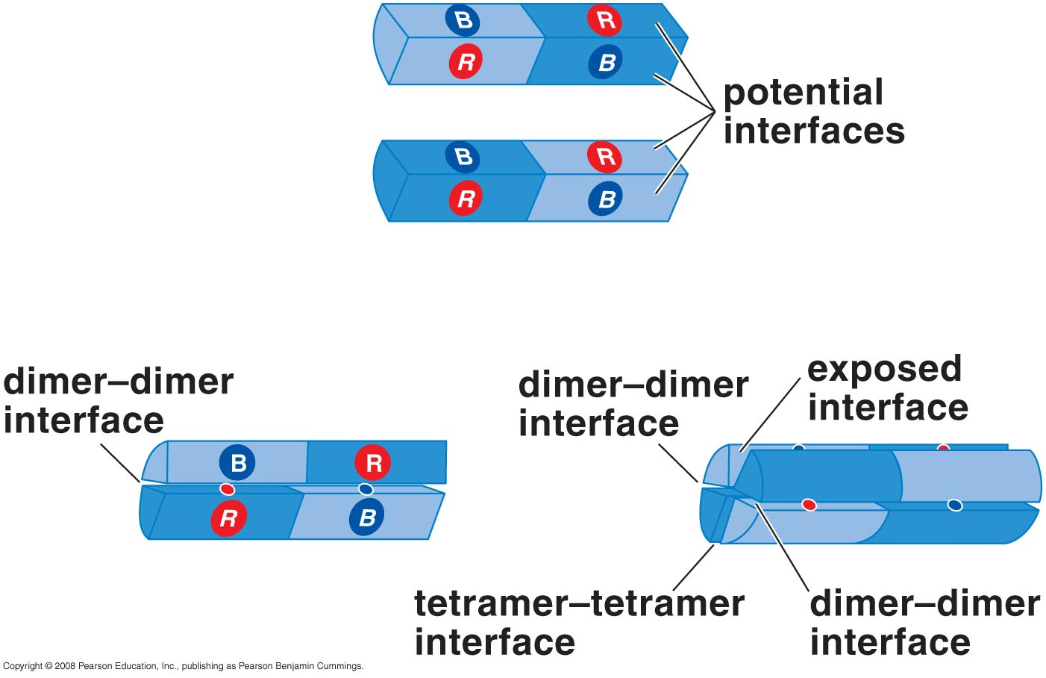
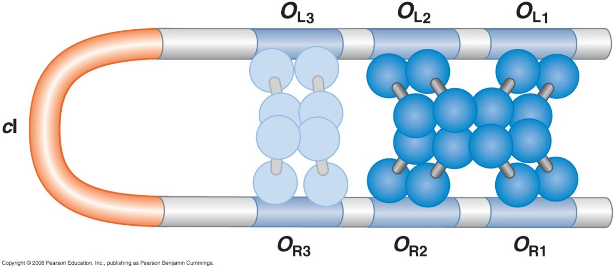
Further repression by interaction between O_{R} and O_{L}
Two tetramers bind O_{R3} &O_{L3} to form Octomer
Binding of λ at O_{R3} &O_{L3} occurs only when high levels of λ are present
Lysogeny is very stable & induction is very efficient

Slide 53
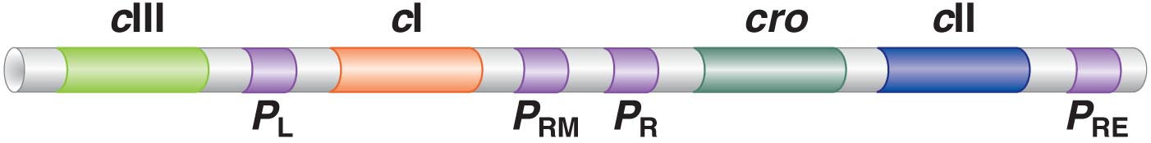
How does a λ phage decide to start as lytic or lysogenic?
cII & cIII genes are responsible for determination whether to go lytic or lysogenic
cII is activator binds to cII binding site and turn on P_{RE}
P_{RE}: Promoter repressor establishment
cIII stabilizes cII

Slide 54
Sequence of events:
λ phage gets into the cell
P_{R} and P_{L} are strong and they are on
  P_{R} → activate cro & cII
  P_{L} → activate cIII
Cro inhibit cI → inhibit λ repressor production → Lytic
cII & cIII promote lysogenic growth …. HOW

Slide 55
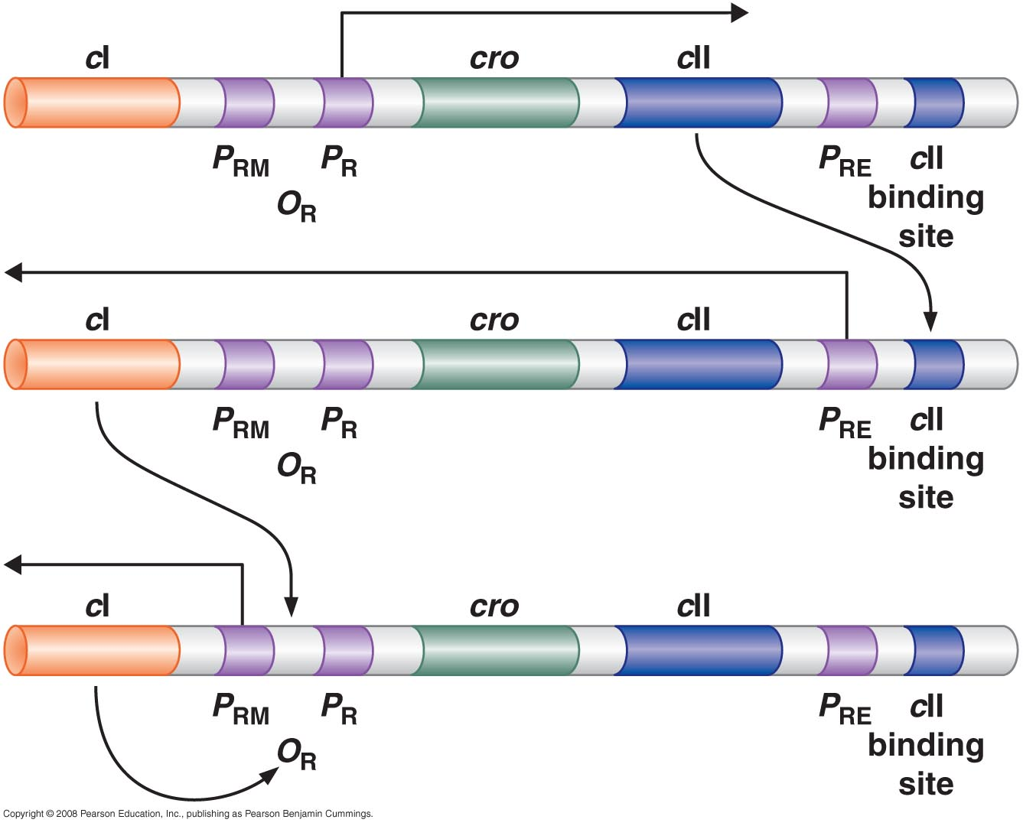
Lysogenic growth established by cII & cIII

Slide 56
Competition between cro and cII & cIII actions which one will win?
What factors determine presence of cII at high levels → lysogenic
Or cII low levels & high levels of cro → lytic?

Slide 57
1- Number of phage in E.coli
If the number of λ phage ≤1 → go lytic
If the number of λ phage ≥ 2 → go lysogenic
  ↑number of λ phage → ↑ transcription from P_{R} & P_{L} → cII & cIII → lysogenic
Once 1st phage got integrated → block others from lytic growth

Slide 58

2- Growth conditions of E.coli
Lytic growth
Lysogenic growth
Both CII & Cro are transcribed
If growth is good → cII protein is damaged quickly by FtsH protease → no activation of cI → no repressor → lytic growth
If growth is poor → cII protein is damaged slowly → activation of CI → λ repressor synthesized → lysogenic growth

Slide 59
cII protein control 3 genes all are important for lysogenic growth
P_{RE} → cI gene → λ repressor
P_{I} → integrase gene → integration
P_{AQ} → middle of Q gene → antisense message to Q RNA which is important for lytic growth (Q degredation)
P_{I}

Slide 60
Transcriptional regulation after initiation
Antitermination
Retroregulation

Slide 61
Transcriptional Antitermination
Transcription can start normally BUT it will terminate prematurely few hundreds or thousand bp as it pass a sequence known as terminator
Antiterminators regulatory proteins N and Q, prevent the termination
Antiterminator recognizes specific sequences located between promoter & terminator

Slide 62
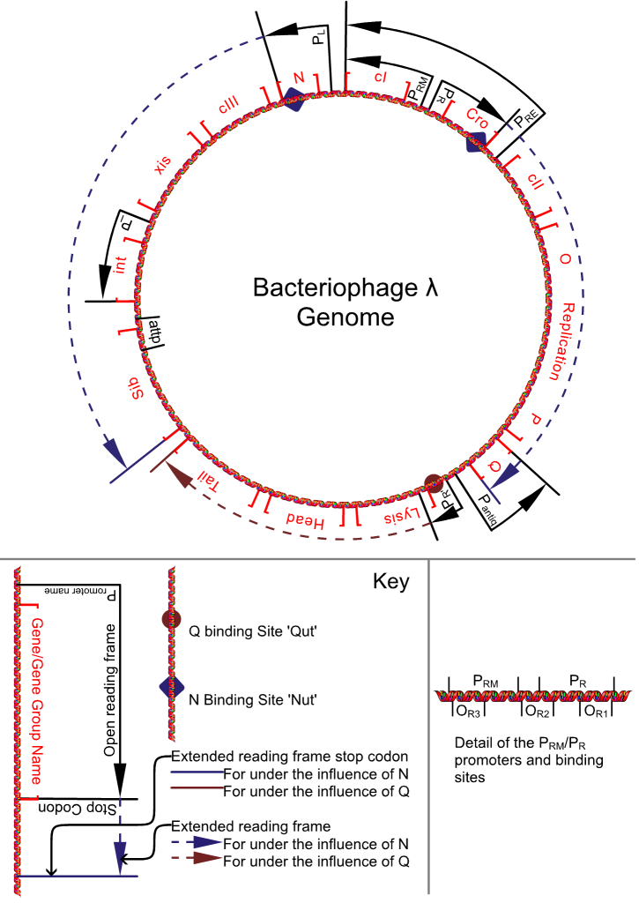
N protein antiterminator
It acts at three terminators:
Left of N gene
Right of cro gene
Between P & Q genes

Slide 63
Q protein antiterminator
It acts at one terminators:
200 nucleotide downstream from P_{R`} Between Q & S genes

Slide 64
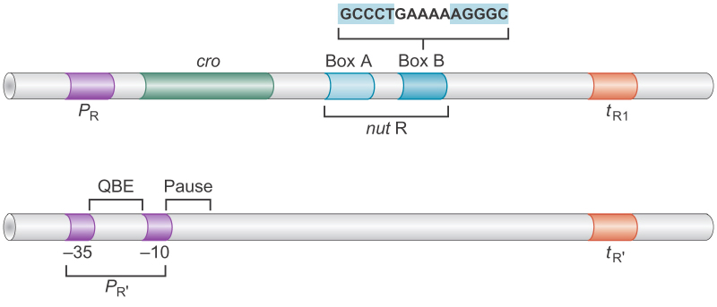
N proteins binds to the RNA transcribed from nut sequence → loaded to RNA polymerase → resistant to terminator sequence t_{R1}
nut : N utilization
Q proteins bind to the QBE DNA site → prevent pause after 16-17 nucleotide.

Slide 65
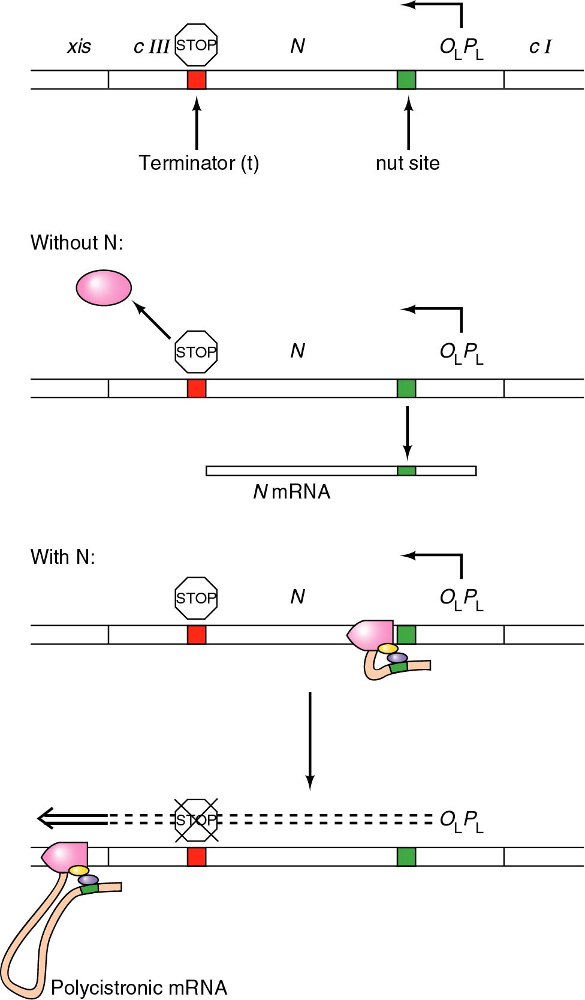
Antitermination by N protein

Slide 66
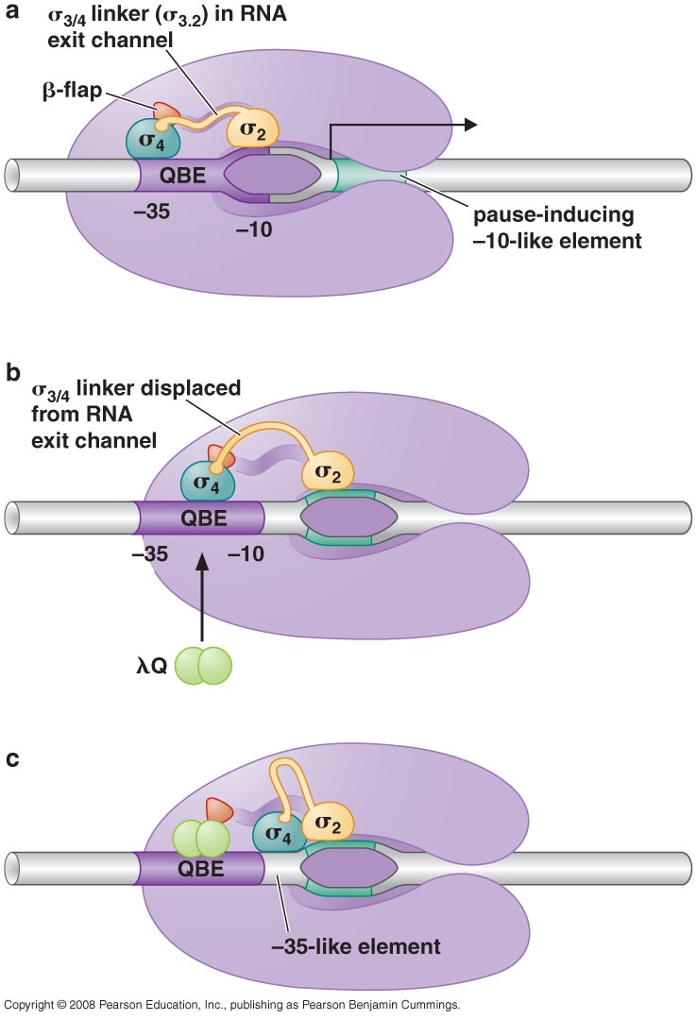
Antitermination action of Q protein

Slide 67
2- Retroregulation
Integrase is produced from two promoters: P_{L} & P_{I}
Only RNA produced from P_{I} is stable and can be transcribed into integrase
mRNA transcribed from P_{L} is longer than that of P_{I}

Slide 68
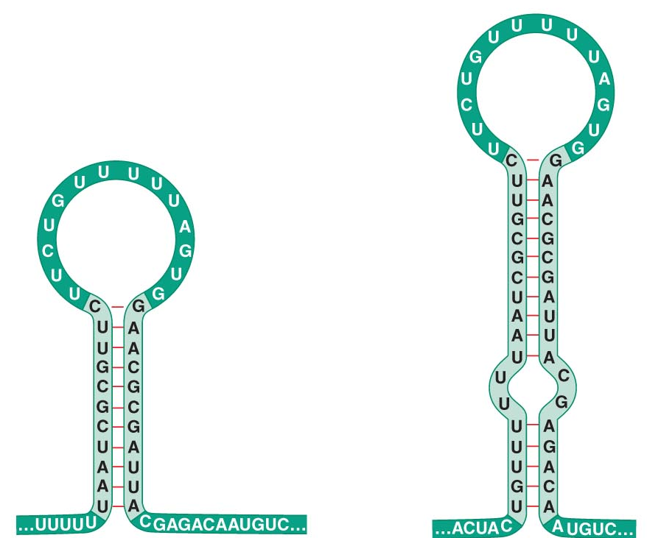
Transcript is a substrate for nuclease → degradation
Retroregulation because:
Site responsible for regulation is downstream of gene it is regulating & degradation proceed backward
transcribed from P_{I}
transcribed from P_{L}

Slide 69
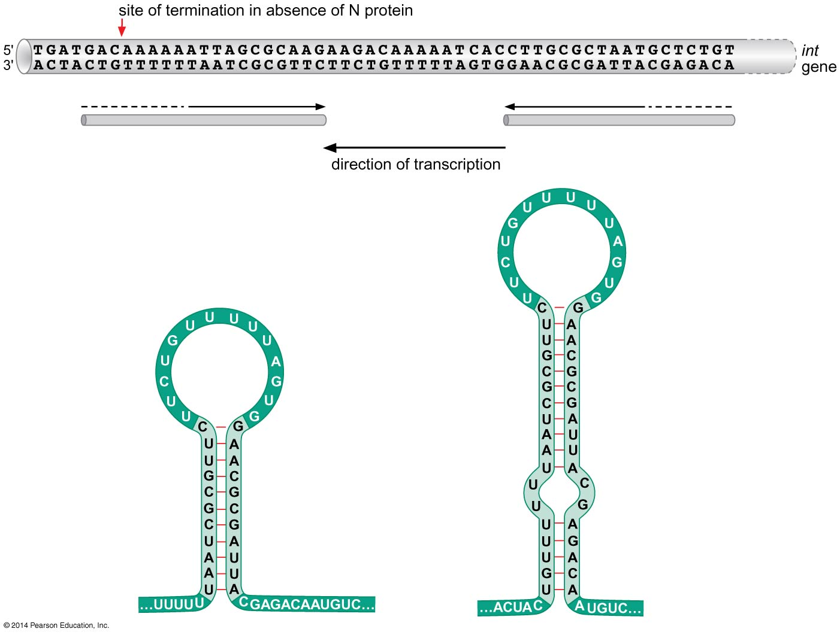
Figure 18-34
Notes:
Figure 18-34

Slide 70
Biological action of retroregulation
When cII activity is low → no inhibition of PL → int. is synthesized from PL →degradation →lytic growth
When cII activity is high → inhibition of PL → int. is synthesized from PI → integrase is produced → lysogenic growth

